Slide 1
Domain: Social Networks, Machine Learning and Natural Language Processing
Probable Title: Social Profile Information Consolidation and Query System
Team:
Rakshitha K Bhat
Rashmi Raghunandan
Sanjana Shankar
Guide:
Prof. Satya Srinivas
Group No: 45

Slide 2
Introduction
Social networks - explosion of data
Unstructured data in natural language
Structured data provided by API
Machine learning techniques - semi supervised learning : more unlabeled data
Natural language processing - sentiment analysis, understanding natural language sentences

Slide 3
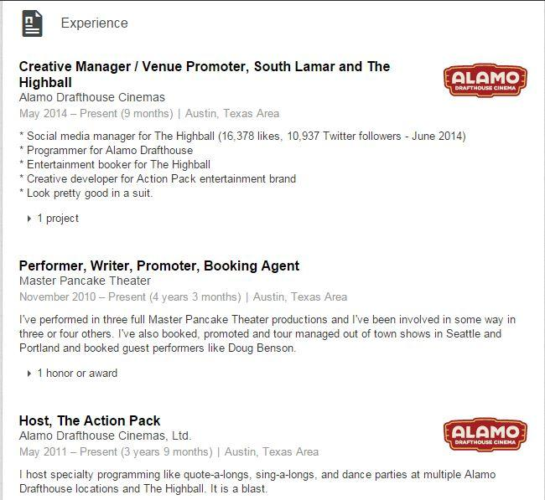
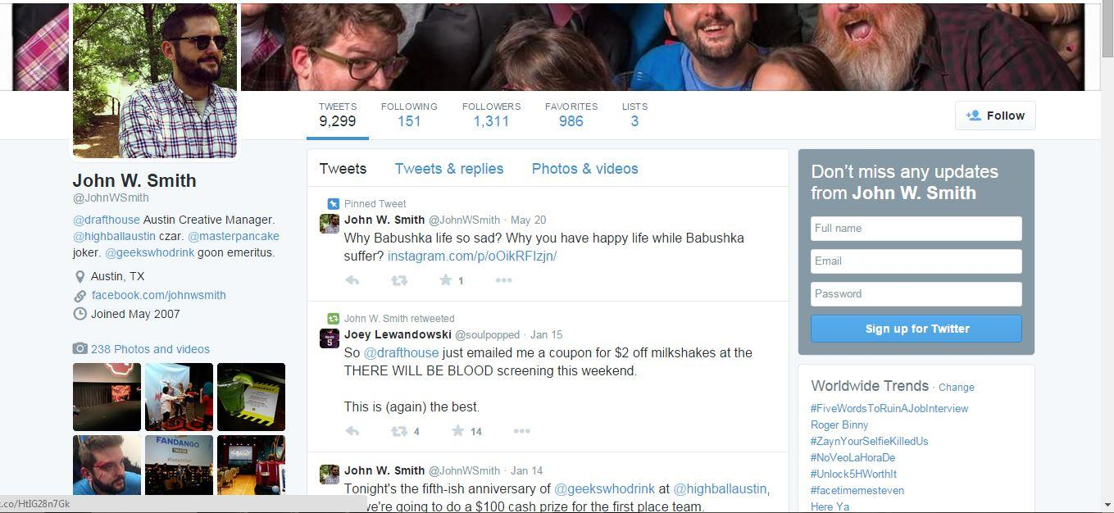
The same person on two social networks presents a completely different profile. Could you take all his networks and get only what information you want in one single place without having to comb through 10 posts about cats or an in-depth description of all his projects?
The issue - with so much data, how do you get all the relevant information about someone in one single place?

Slide 4
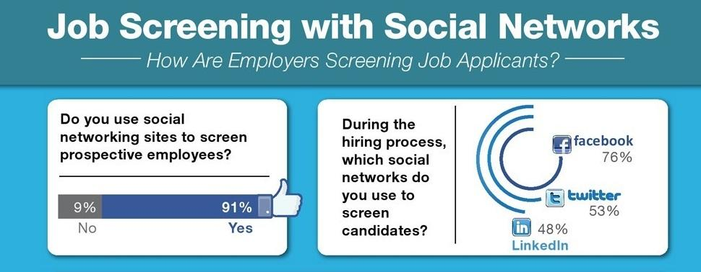
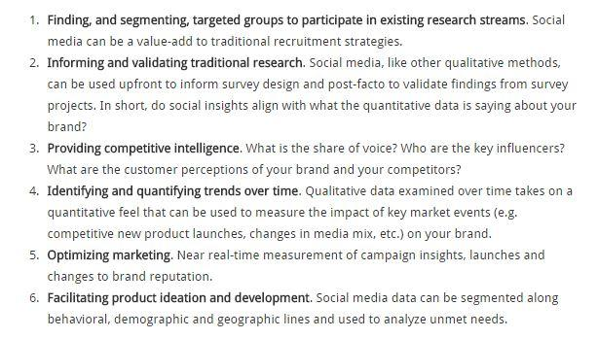
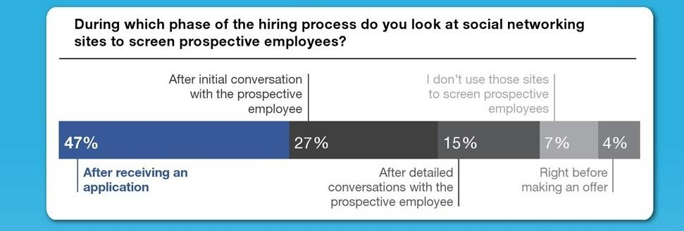
Motivation
Using social media for market research : Methodology
Aadhar hackathon
Many hackathons face the same issue of shortlisting
Notes:
Facebook and Twitter are being used a lot to screen job applicants. On Facebook and Twitter, hirers are trying to get a more personal view of a candidate, rather than the resume-like view they will see on LinkedIn.
Hirers are looking at the social networking profiles of candidates very early in the process. This means that job seekers need to have their online act in order before they begin looking for a job.
First picture – social market research approach – relies on surveys and groups to find interested people. For an upcoming business or a self-published author, marketing starts from his own friend list or people in groups. However, it is important to find people who are really interested and who haven’t simply liked or upvoted a page in order to propagate information. It’s important that advertising reaches the right people. How to do that using the large number of social media profiles available. How to find out what people are currently interested in? (add something about openstack and financial companies example?)
Second picture – background screening – largely outsourced to other companies that perform thorough checks and even dig into court records. Downside, extra cost, time consuming if you don’t want to go too much into detail. Also, how to not take posts made five years ago into account and obtain relevant posts without needing to manually go through pages and pages of posts?
Third picture – hackathon scale. One single hackathon drew 1800 applicants out of which 140 were chosen. That’s only 7.7% of applicants. What if there was an easier way to shortlist some of them based on their technical skills and interests to see if they would be a good match for this hackathon and verifying their qualifications instead of having to look at all 1800 profiles submitted?
Who has the time to do all this!

Slide 5







Name
Age
Location
Technical skills:
Languages
Tools
Databases
Social:
Goes out often
Foodie
Enjoys gardening
Projects:
Home automation application
Restaurant selector
Automatic book gen
Other interests:
Food
Reading
Rock music
Popularity:
783 friends
625 followers
529 connections
Want to know more? Just search here…

Slide 6
Features
Extract information from profiles according to the use case requirements
Create a profile template with categories that can be selected by the user or provided by us
Classify the extracted information as per the categories and present in the template
Allow the user to select several specific information within a category
Allow the user to save a profile template for further use
Provide a querying system for the user
Notes:
information extraction from structured and unstructured data - explain about post analysis, derived attributes like number of working hours from number of times he commits etc.
explain about categories - Education, Technical, Projects, Work, Non_technical skills (singing etc.), Social - how many friends, how often you go out etc. , Popularity, Tech_Interests (codechef and other techy stuff to follow), Non_Tech_Interests (books you read)

Slide 7
Features
7. Use ontology to aid in understanding user queries
and reduce dependence on supervised training
8. Allow user to specifically add an item to a
category for improved (supervised) learning
Challenges:
Permissions from the subject
Information is relevant only over a time period
Natural language may contain slang and grammatically incorrect sentences.

Slide 8
Current Products
Job screening - largely manual analysis and proprietary algorithms
Sentiment analyzers
Social media managers
IBM Watson
Trending topic generators
Consolidated feeds
Notes:
background screening - Social Intelligence and SterlingBackCheck
aggregators - they only provide a means of consolidating your social media profiles in one place - like a dashboard where you can control all your profiles, you can’t see other people’s things
feeds - show only posts you’re interested in
WATSON - personality generation

Slide 9
Thank you!

Slide 10
References
http://theundercoverrecruiter.com/infographic-how-recruiters-use-social-media-screen-applicants/
Reppler
http://www.go-gulf.com/blog/social-media-pre-employment-screening/
http://researchaccess.com/2014/12/social-media-analytics/
https://www.go2hr.ca/articles/background-checks-using-social-media-sites
http://yourstory.com/2015/01/aadhaar-hackathon-winners/

Slide 11
Literature survey
Mining the social web: Matthew A. Russell
Finding High-Quality Content in Social Media: Eugene Agichtein, Carlos Castillo, Debora Donato, Aristides Gionis, Gilad Mishne
Using Social Data as Context for Making Recommendations: An Ontology based Approach: Salma Noor, Kirk Martinez
Representing, Querying and Transforming Social Networks with RDF/SPARQL: Mauro San Martín1, Claudio Gutierrez
Mining Knowledge from Text Using Information Extraction: Raymond J. Mooney and Razvan Bunescu

Slide 12
Approach
Gather data from social media sites
Semi-supervised training to classify content into pre defined classes.
Crawl the web to identify unknown classes.

Slide 13
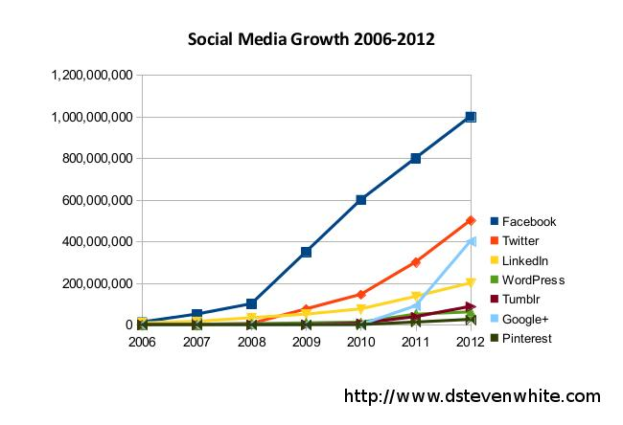
Introduction

Slide 14
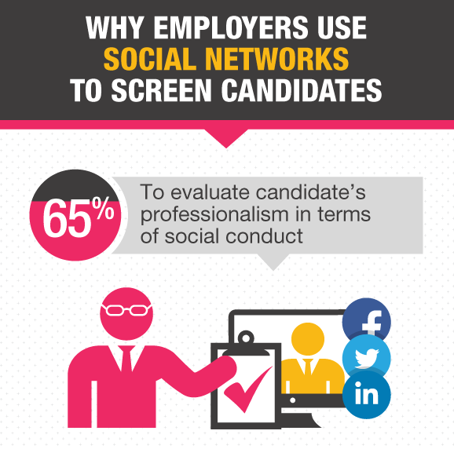
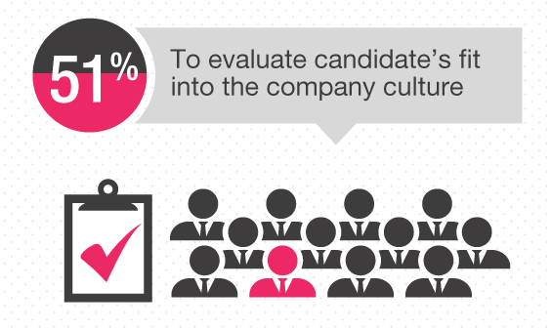
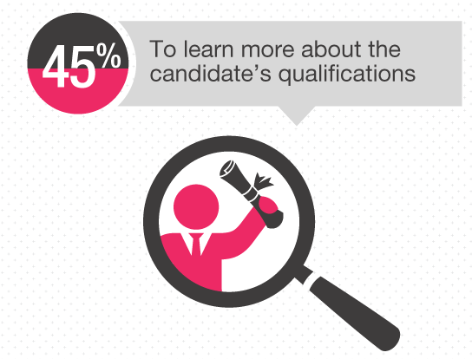
Notes:
Social media recruiting does present a new opportunity for hiring managers to expand their applicant pool, but there are several reasons employers should use caution if they choose to screen the social media accounts of job candidates.

Slide 15
